Slide 1
Deepfake Detection Using Deep Neutral Networks
Runmay Shirsat - 60008240006

Slide 2
Content
Introduction
Literature Review
Problem Statement
Architectural Design
Dataset
Implemented Model
Model Performance on Datasets
Conclusion
Reference

Slide 3
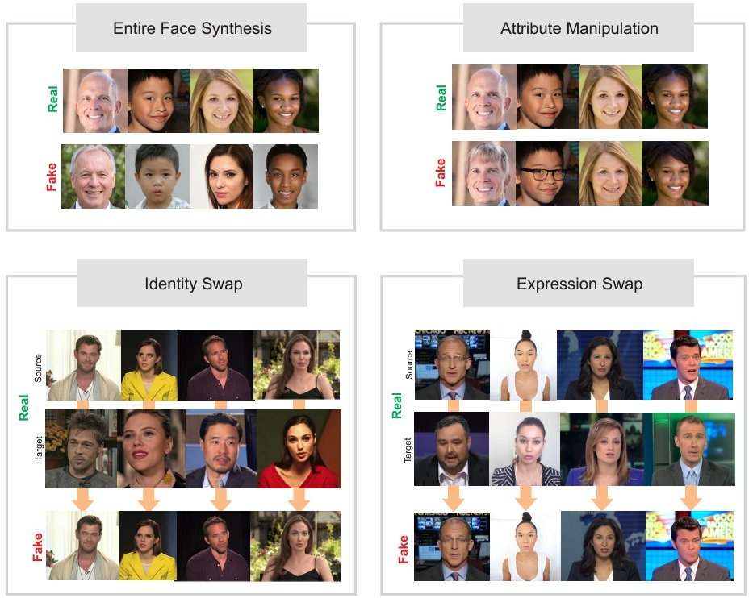
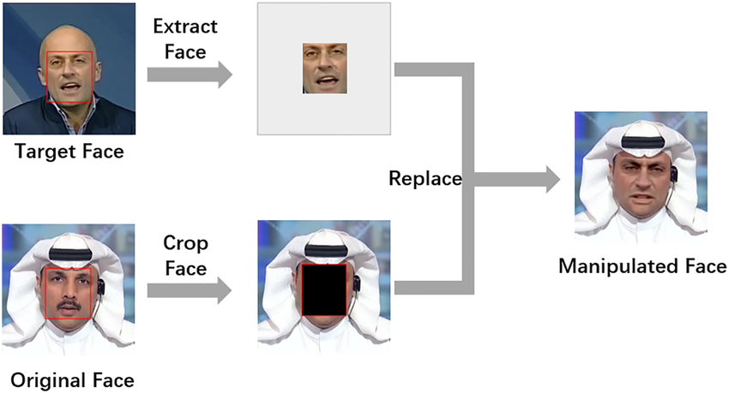
Introduction
Deepfakes are hyper-realistic images and videos created using artificial intelligence. They can be used to make it appear as if someone is saying or doing something they never did.
Facial manipulations can be categorized in four main different groups:
Entire face synthesis
Attribute manipulation
Face/Identity swap
Expression swap

Slide 4

Introduction
A deepfake video is a type of manipulated media that uses artificial intelligence and deep learning techniques to alter or replace the original content in a video. The term "deepfake" is derived from "deep learning" and "fake, signifying the use of deep neural networks to create convincingly realistic but fabricated videos.
Deep fake detection is the process of identifying and verifying the authenticity of images and videos. This is important because deepfakes can be used to spread misinformation and damage people's reputations.

Slide 5
Problem Statement
The growing prevalence of deepfake technology poses significant challenges in ensuring the authenticity of digital media. To address this issue, the goal of this project is to develop an deepfake detection system using deep neural networks.
The system will extract frames from videos, crop faces from those frames, and use them to train a model capable of distinguishing between real and manipulated faces. Two different datasets will be used for training, and the model's performance will be evaluated to identify the best-performing model for accurate deepfake detection.
This system aims to enhance the reliability and security of digital content through efficient and effective deepfake detection.

Slide 6
Literature Review
1 .Video deepfake detection using Particle Swarm Optimization
Deepfake detection is crucial due to the increasing misuse of AI-generated synthetic media, threatening privacy and societal stability. A hybrid model combining EfficientNet for spatial feature extraction and GRU for handling temporal sequences has shown promise in identifying deepfakes. To enhance performance, Particle Swarm Optimization (PSO) is employed for automated hyperparameter tuning, improving the model's accuracy and efficiency.Datasets such as Celeb-DFv2 and DFDC, which include a variety of real and fake videos, are used to evaluate detection systems. The preprocessing pipeline involves frame extraction, face detection and cropping, followed by resizing for model input. The PSO-optimized EfficientNet-GRU model demonstrated superior accuracy, recall, and AUC scores on these datasets, underscoring its effectiveness.
This study sets a benchmark in deepfake detection by integrating advanced architectures with optimization techniques, showcasing the potential of hybrid models like EfficientNet-GRU in addressing the challenges posed by deepfakes.
2. Deepfake Detection System Using Deep Neural Networks
This research focuses on detecting deepfake images generated by StyleGAN using hybrid deep learning models. A dataset of 1,000 real and 1,000 fake images from FFHQ and StyleGAN was used, preprocessed through alignment, resizing, and augmentation. Three hybrid models were tested: EfficientNetB4-LSTM, InceptionV3-LSTM, and InceptionResNetV2-LSTM, combining CNNs for spatial feature extraction and LSTMs for temporal classification. EfficientNetB4-LSTM achieved the highest accuracy (98%) and the shortest training time, outperforming the other models. Despite limitations like small dataset size and reduced image resolution, the study highlights the potential of hybrid CNN-LSTM models for deepfake detection. Future work will involve expanding the dataset and improving computational resources.

Slide 7
Literature Review
3. An Efficient Deepfake Video Detection Approach with Combination of EfficientNet and Xception Models Using Deep Learning
This paper explores the use of advanced CNNs to address the growing issue of deepfake videos. Utilizing EfficientNet-B4 and XceptionNet, the research focuses on their ability to classify images accurately. EfficientNet-B4, known for balancing accuracy with computational efficiency, achieved superior performance with an AUC of 0.99 and a log loss of 0.02, outperforming XceptionNet’s AUC of 0.98 and log loss of 0.04. Datasets FaceForensics++ and Celeb-DF (v2) were used, with preprocessing centered on frame extraction and facial region isolation. The study underscores the necessity for ongoing improvements in detection algorithms to counter evolving deepfake technologies.
4. Detecting Deepfakes With ResNext and LSTM: An Enhanced Feature Extraction and Classification Framework
Deepfake video detection is crucial due to the rise of GANs. Methods focus on identifying artifacts, using ResNext for spatial features and LSTMs for temporal inconsistencies, achieving over 95% accuracy on datasets like FaceForensics++. The absence of physiological signals, such as eye blinking, is also a key indicator. The ResNext-LSTM model accurately classified one-second video segments, demonstrating its robustness. Capsule networks and conditional adversarial networks have shown similarly high performance across diverse datasets, proving resilient to varying video qualities and attack methods. These results underscore the effectiveness of deep learning techniques in addressing deepfake detection challenges.

Slide 8
Literature Review
5. Fake Video Detection Model Using Hybrid Deep Learning Techniques
Deepfake detection is vital to combat AI-generated fake content in misinformation and scams. Advanced deep learning models, particularly ResNext and LSTM, effectively identify facial anomalies and temporal inconsistencies. ResNext extracts frame-level features, detecting manipulation artifacts, while LSTM processes sequential data for accurate classification. The ResNext-LSTM approach achieved over 95% accuracy on datasets like FaceForensics++ and Kaggle’s Deepfake Detection Challenge. Other models, such as Modified AlexNet and Deep InceptionNet, also show competitive results. Techniques like eye-blinking detection enhance capabilities by targeting deepfake limitations. These deep learning methods offer scalable solutions, continually advancing to counter evolving deepfake technologies.

Slide 9
Literature Review
Study Title | Models Used | Datasets | Key Techniques | Performance | Remarks
Deepfake Detection Using EfficientNet and GRU | EfficientNet-GRU | DFDC | Hybrid model combining CNN and RNN; PSO for hyperparameter tuning | High accuracy, recall, and AUC | Demonstrated the effectiveness of integrating PSO with EfficientNet-GRU for enhanced detection
Deepfake Detection System Using Deep Neural Networks | EfficientNetB4-LSTM, InceptionV3-LSTM, InceptionResNetV2-LSTM | FFHQ, StyleGAN (1,000 real, 1,000 fake images) | Hybrid models for spatial and temporal feature extraction | EfficientNetB4-LSTM achieved 98% accuracy | EfficientNetB4-LSTM balanced high accuracy with lower training time
An Efficient Deepfake Video Detection Approach with Combination of EfficientNet and Xception Models Using Deep Learning | EfficientNet-B4, XceptionNet | FaceForensics++, Celeb-DFv2 | Frame extraction, facial region isolation, depthwise separable convolutions | EfficientNet-B4: AUC 0.99, Log loss 0.02; XceptionNet: AUC 0.98 | EfficientNet-B4 more accurate and efficient than XceptionNet
Detecting Deepfakes With ResNext and LSTM: An Enhanced Feature Extraction and Classification Framework | ResNext, LSTM | FaceForensics++, 50% real/50% fake curated datasets | CNN for spatial features, RNN for temporal analysis, physiological signal detection | Over 95% accuracy | Combined ResNext-LSTM approach effectively captured spatial and temporal inconsistencies
Fake Video Detection Model Using Hybrid Deep Learning Techniques | ResNext-LSTM, Modified AlexNet, Deep InceptionNet | FaceForensics++, Kaggle’s Deepfaake Detection Challenge | Anomaly detection in facial features and motion, eye-blinking detection | ResNext-LSTM: Over 95% accuracy | Explored multiple models, emphasizing the robustness of ResNext-LSTM in identifying deepfake content

Slide 10
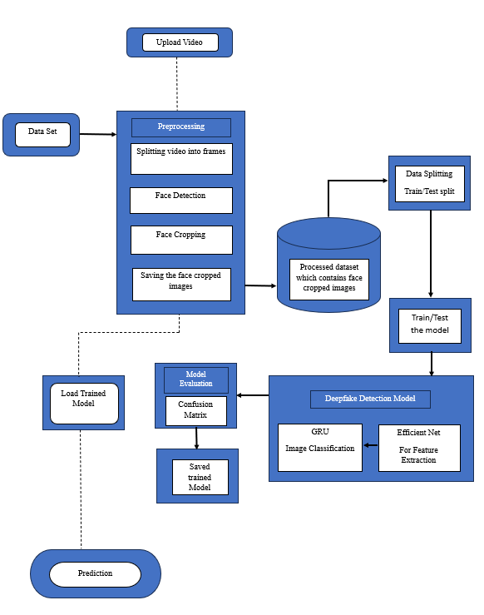
Architectural Design

Slide 11
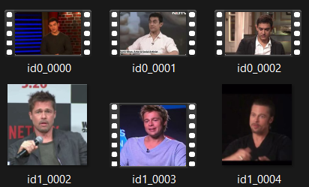
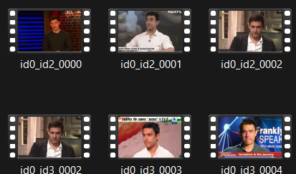
DATA SET
Original
In this project, we utilize two prominent datasets for deepfake detection:
1. Celeb-DF (Version 2)
Celeb-DF (v2) is a large-scale dataset designed to advance deepfake forensics research.
Content:
Original Videos: 590 high-quality videos featuring celebrities of diverse ages, ethnicities, and genders, sourced from YouTube.
DeepFake Videos: 5,639 videos generated using advanced face-swapping techniques, closely resembling real-world deepfake content.
In the Celeb-DF dataset, 500 videos each from the original and deepfake categories were utilized for training, while 50 videos from each category were set aside for testing.
Manipulated

Slide 12
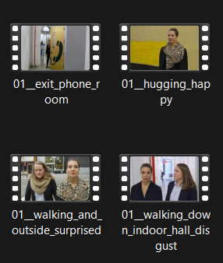
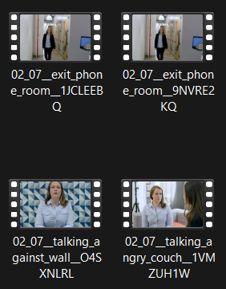
DATA SET
2. DeepFake Detection Challenge (DFDC)
The DFDC dataset is one of the largest publicly available collections for deepfake detection, developed to encourage the creation of robust detection methods.
Content:
Actors: Features videos from 3,426 paid actors, ensuring a wide range of appearances and behaviors.
Videos: Over 100,000 clips produced using various deepfake generation techniques, including GAN-based and non-learned methods.
In the DFDC dataset, 300 videos each from the original and deepfake categories were utilized for training, while 60 videos from each category were set aside for testing.
Original
Manipulated

Slide 13
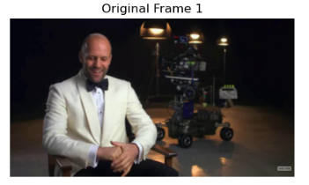
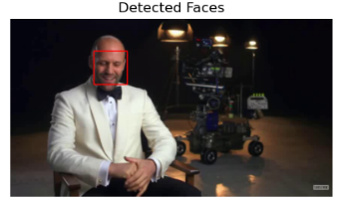
PREPROCESSING
1. Frame Extraction:
The video is split into frames at regular intervals
Each frame is converted from the default BGR format (used by OpenCV) to RGB for accurate color display.
2. Face Detection:
A Haar cascade classifier is used to detect faces in each frame.
Detected faces are highlighted with rectangles on the original image.

Slide 14
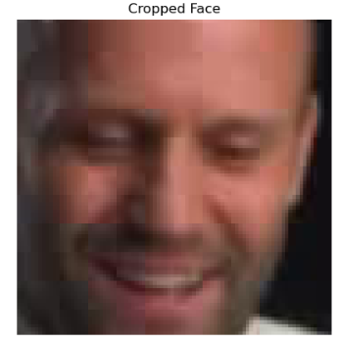
PREPROCESSING
3. Face Cropping:
The regions corresponding to detected faces are cropped from the original frame, isolating the face areas.
4. Resizing Faces:
Each cropped face is resized to a consistent size (e.g., 224x224 pixels) to standardize the input for further processing or model use.
5. Saving the Image:
Each processed image is saved as an individual file for analysis

Slide 15
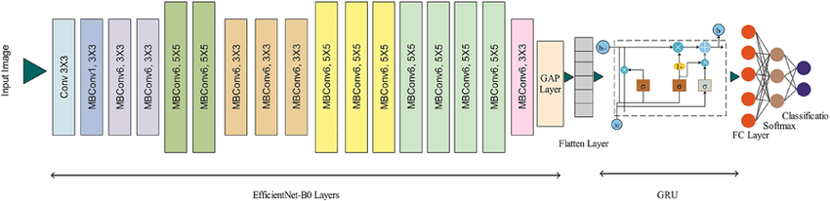
Implemented Model
EfficientNet‐b0 + GRU
The model combines EfficientNet-B0 for feature extraction and a GRU (Gated Recurrent Unit) layer for sequence processing, followed by a fully connected layer for binary classification (Real or Fake).

Slide 16
Implemented Model
Hyperparameters
EfficientNet:
Pre-trained Backbone: EfficientNet-B0 (trained on ImageNet).
Feature Dimension: The output from the EfficientNet feature extractor is reduced using Global Average Pooling (GAP).
GRU:
Hidden Units: 128.
Layers: 2.
Bidirectional: Enabled to improve temporal understanding.
Fully Connected Layer:
Input Size: 256 (concatenated output of bidirectional GRU).
Output Size: 2 (binary classification for Real or Fake).
Sequence Length: 10 frames per video.
Batch Size: 8.
Optimizer: Adam with default settings.
Loss Function: Cross-Entropy Loss.

Slide 17
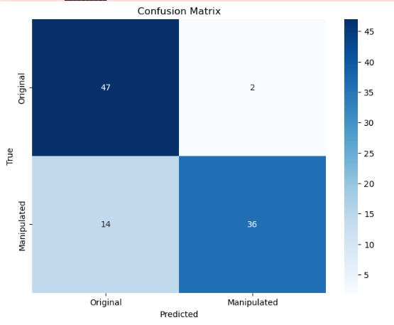
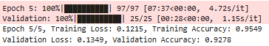
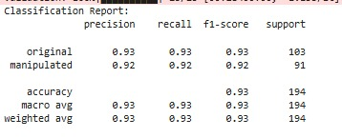
Model Performance on the Dataset
1. Celeb DF

Slide 18
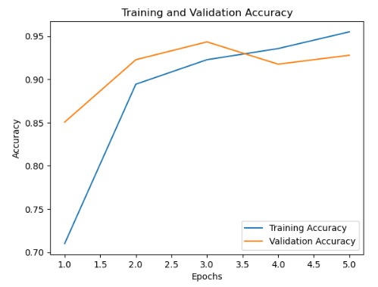
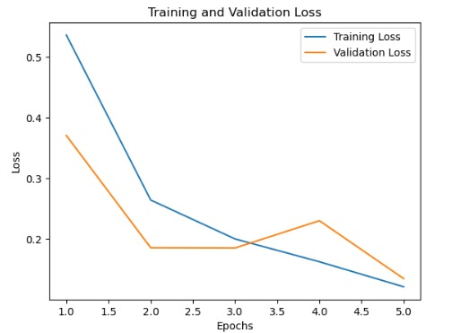
Model Performance on the Dataset
1. Celeb DF
Both training and validation accuracy increase steadily and remain close together, suggesting good generalization with minimal overfitting.
Training and validation loss curves show a good balance with the validation loss stabilizing, suggesting minimal overfitting.

Slide 19
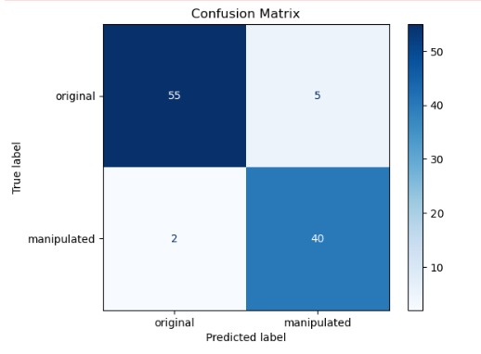
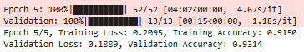
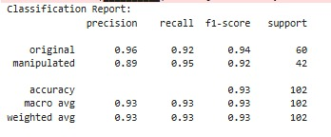
Model Performance on the Dataset
2. DFDC

Slide 20
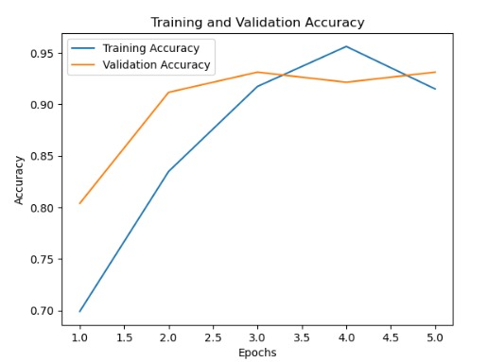
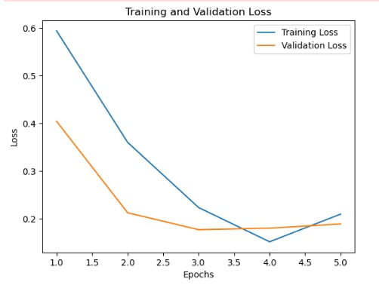
Model Performance on the Dataset
2. DFDC
Training accuracy continues to decrease, while validation accuracy plateaus or slightly increases, indicating a higher risk of overfitting.
The validation loss curve shows a slight increase towards the end, indicating a higher risk of overfitting.

Slide 21
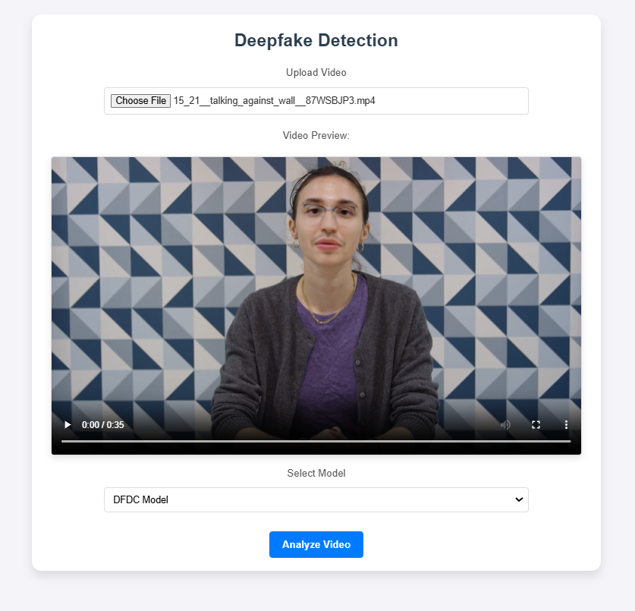
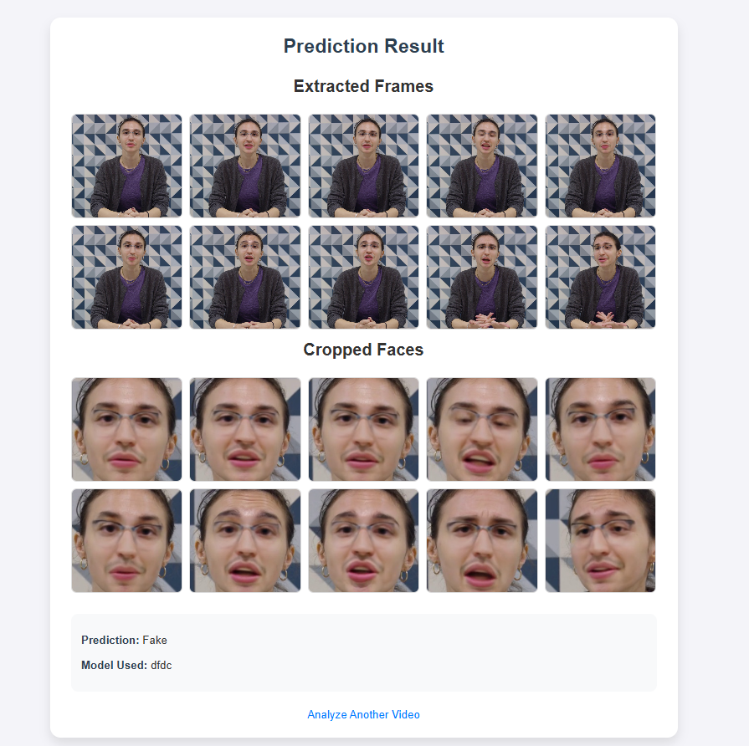
Making Prediction Using Saved Model
1. User Giving Input
2. Prediction Result

Slide 22
Conclusion
This project successfully developed a deepfake detection system using deep neural networks, integrating EfficientNet and GRU for spatial and temporal feature extraction. Trained and evaluated on the Celeb-DF and DFDC datasets, the model achieved high accuracy, reaching 0.9549 on Celeb-DF and 0.9314 on DFDC, with robust performance in distinguishing real and fake videos. The preprocessing pipeline efficiently handled frame extraction, face detection, and resizing, ensuring high-quality input for training. Evaluation metrics, including the confusion matrix and classification report, demonstrated low rates of false positives and false negatives, confirming the model's reliability.

Slide 23
References
Cunha, L., Zhang, L., Sowan, B. et al. Video deepfake detection using Particle Swarm Optimization improved deep neural networks. Neural Comput & Applic 36, 8417–8453 (2024).
M. L. Saini, A. Patnaik, Mahadev, D. C. Sati and R. Kumar, "Deepfake Detection System Using Deep Neural Networks," 2024 2nd International Conference on Computer, Communication and Control (IC4), Indore, India, 2024, pp. 1-5, doi: 10.1109/IC457434.2024.10486659. keywords: {Deep learning;Deepfakes;Visualization;Video games;Streaming media;Vectors;Convolutional neural networks;Deepfake;Fake contents;Deep Neural Networks;Generative Adversarial Networks (GANs);Anvil Platform},
S. AtaŞ, İ. İlhan and M. KarakÖse, "An Efficient Deepfake Video Detection Approach with Combination of EfficientNet and Xception Models Using Deep Learning," 2022 26th International Conference on Information Technology (IT), Zabljak, Montenegro, 2022, pp. 1-4, doi: 10.1109/IT54280.2022.9743542. keywords: {Deep learning;Anxiety disorders;Companies;Data models;Forgery;Information technology;Artificial intelligence},
R. Taviti, S. Taviti, P. A. Reddy, N. R. Sankar, T. Veneela and P. B. Goud, "Detecting Deepfakes With ResNext and LSTM: An Enhanced Feature Extraction and Classification Framework," 2023 International Conference on Signal Processing, Computation, Electronics, Power and Telecommunication (IConSCEPT), Karaikal, India, 2023, pp. 1-5, doi: 10.1109/IConSCEPT57958.2023.10170580. keywords: {Deepfakes;Visualization;Machine learning algorithms;Finance;Signal processing;Media;Feature extraction;Deepfakes;ResNext;LSTM;CNN},
O. S. A. Aboosh, A. N. Hassan and D. K. Sheet, "Fake Video Detection Model Using Hybrid Deep Learning Techniques," 2023 6th International Conference on Information and Communications Technology (ICOIACT), Yogyakarta, Indonesia, 2023, pp. 499-504, doi: 10.1109/ICOIACT59844.2023.10455952. keywords: {Deep learning;Graphics;Deepfakes;Image forensics;Recurrent neural networks;Logic gates;Feature extraction;DeepFake;FaceSwap;Face2Face;Gated Recurrent Unit;InceptionV3;Recurrent Neural Network},

Slide 24
THANK YOU!

